Slide 1
West Manor Elementary
GO Team Business Meeting #3
DATE 11/11

Slide 2

Agenda
Action Items
  Approval of Agenda
  Approval of Previous Minutes
Discussion Items (add items as needed)
  2025-2030 Strategic Plan Development
    Confirm Mission/Vision, Goals from Previous Meeting
    Develop 2025-2030 Strategic Plan Objectives
Information Items Principal’s Report
  Cluster Advisory Team Report
  APS Forward 2040 –Facilities Plan Update Announcements
Public Comment
Adjournment

Slide 3

Action Items
Approval of Agenda
Approval of Previous Minutes

Slide 4
Discussion Items

Slide 5
Continuing the
2025-2030 School Strategic Plan Development Process

Slide 6
School Strategic Planning Overview
Purpose
To cascade the district strategic plan to the school level, while grounding our focus in the school’s Continuous Improvement Plan. This will create alignment, reduce confusion, and simplify our efforts.
Timeline
Our school’s 2030 Strategic Goals and Objectives should be updated, approved and ranked by January 2026. Schools will focus on the strategies as part of FY27 Budget and Continuous Improvement Plan processes.

Slide 7
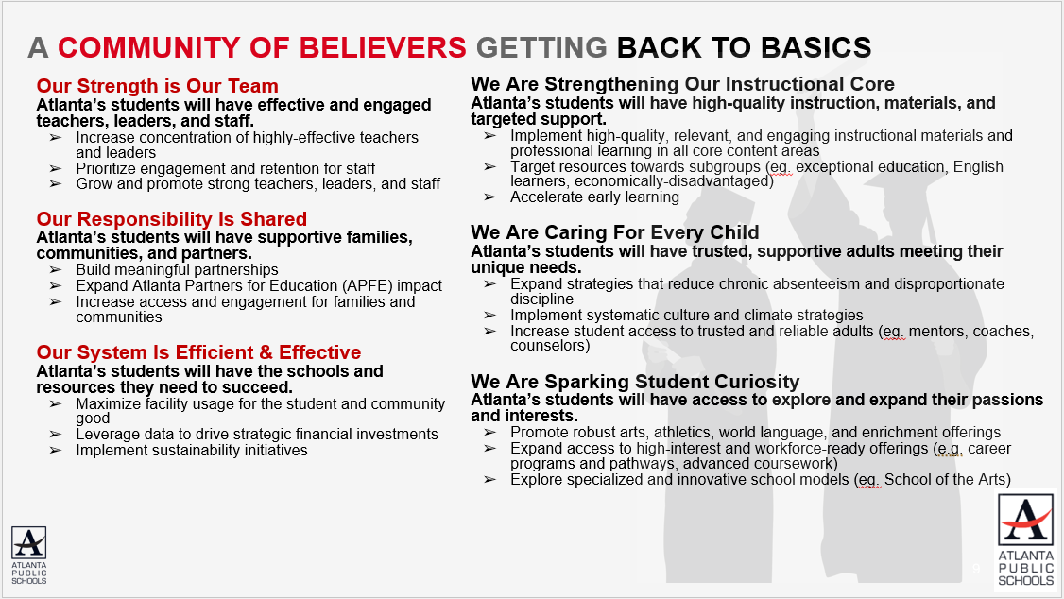
Revisiting the APS 2025-2030 Strategic Plan
Notes:
As a reminder this is the district's 2025-2030 Strategic Plan. We will use this as a guide as we continue our work today to develop our school's 2025-2030 Strategic Plan that is aligned to the district's new plan.

Slide 8
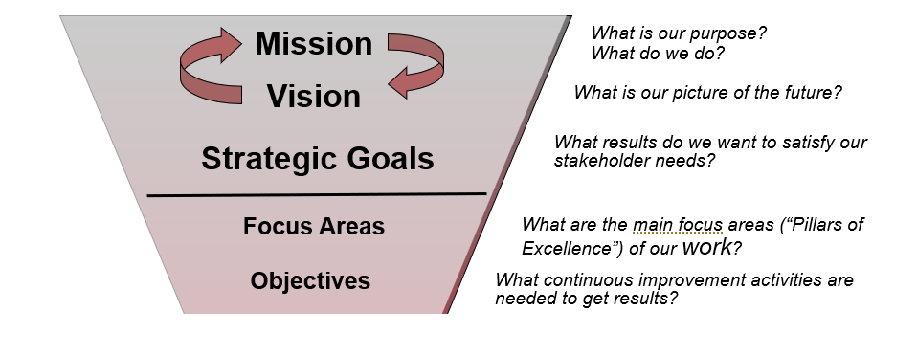
GO Team’s Focus (Governance)
Notes:
These are the governance-aligned portions of the school strategic plan that the GO Team will develop. We will dive into specific strategies and actions, as a part of our budget development process that starts in January.

Slide 9

School Strategic Planning Process Overview
1
Review Data
Sample GO Team Business Meeting Cadence
Business Meeting 1:
Review Data (MAP, GMAS, Graduation Rate, CCRPI, etc.)
Business Meeting 2:
Review Data (School KPIs)
Align Mission/Vision/ Purpose
Confirm 2030 Goals
Business Meeting 3:
Identify 2025-2030 Strategic Objectives
Business Meeting 4 (Budget Allocation):
Approve Your Strategic Plan & Rank Your Strategic Objectives for FY27
2
Align Mission/Vision/Purpose
3
Confirm 2030 Goals
Create CIP Goals to 2030
Identify Additional Goals
4
Identify 2025-2030 Strategic Objectives
Reflect on 2020-2025 Strategic Plan
Review and Discuss Additional Objectives Going Forward
5
Approve Your Strategic Plan & Rank Your Strategic Objectives for FY27

Slide 10
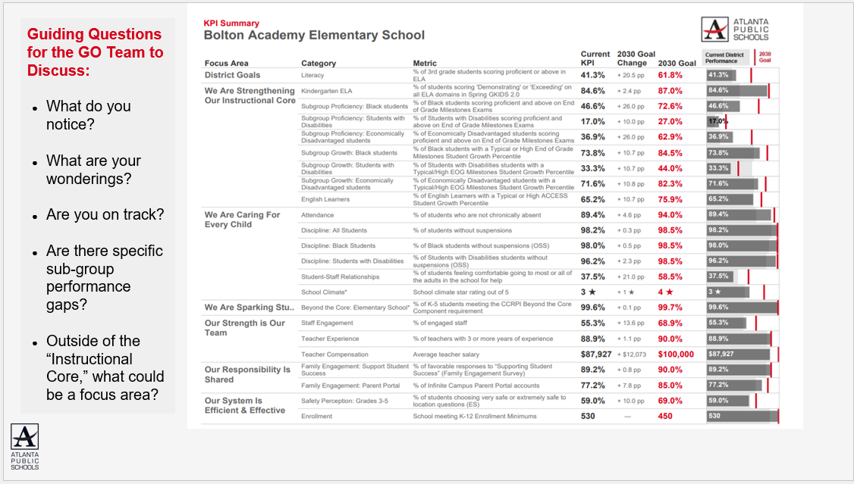
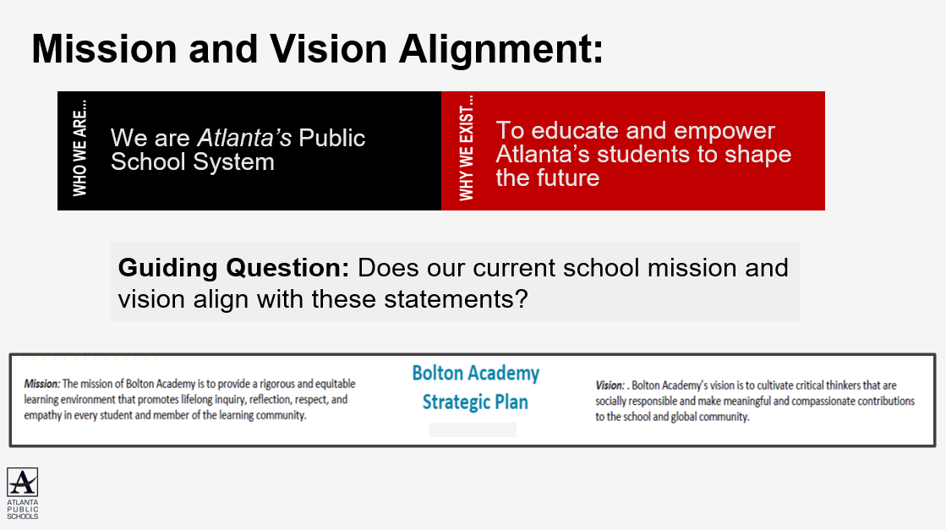
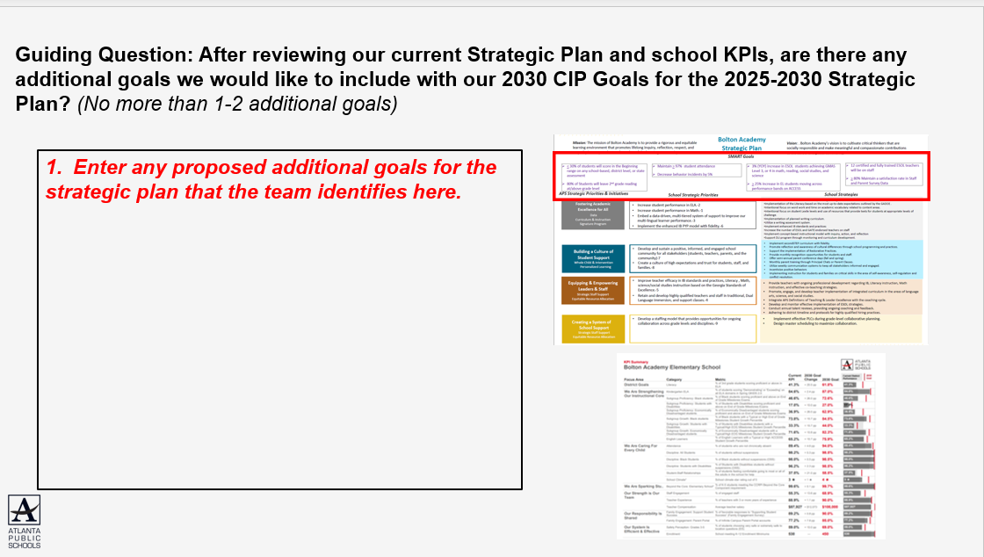
In Our Last Meeting We…
1
Reviewed Our
School Data
2
Aligned Our
Mission and Vision
3
Confirmed Our
2030 Goals

Slide 11

West Manor Mission and Vision:
The MISSION
West Manor Elementary School commits to cultivating inquiring, knowledgeable and caring scholars who strive to think, act, and reflect with a value and understanding of multiple cultures, languages, and perceptions.
To this end, the school will work collaboratively with all stakeholders to meet the needs of all learners while providing a safe and supportive learning environment. The school implements a rigorous, inquiry-driven international curriculum which supports the development of socially, emotionally, and academically balanced lifelong learners who are committed to creating a more peaceful world through intercultural understanding and respect.
The VISION
The vision of West manor is to be a nurturing, comprehensive, and high performing school where faculty, staff, parents, and all stakeholders will concertedly prepare our students to become globally productive citizens and leaders.

Slide 12

West Manor Proposed Goals for the 2025-2030 Strategic Plan:
During the 2025 school year we will Increase the number of students in grades 3-5 scoring proficient from 35 % to 40% on ELA Milestones
During the 2025 school year we will Increase the number of students in grades 3-5 scoring proficient from 32 % to 37% on Math Milestones
During the 2025 School year we will increase the number of students with 10 or less days absent from 74% to 80%

Slide 13

Today’s Focus:
School Strategic Planning Process: Step 4
1
Sample GO Team Business Meeting Cadence
Business Meeting 1:
Review Data (MAP, GMAS, Graduation Rate, CCRPI, etc.)
Business Meeting 2:
Review Data (School KPIs)
Align Mission/Vision/ Purpose
Confirm 2030 Goals
Business Meeting 3:
Identify 2025-2030 Strategic Objectives
Business Meeting 4 (Budget Allocation):
Approve Your Strategic Plan & Rank Your Strategic Objectives for FY27
Review Data
2
Align Mission/Vision/Purpose
3
Confirm 2030 Goals
Create CIP Goals to 2030
Identify Additional Goals
4
Identify 2025-2030 Strategic Objectives
Reflect on 2020-2025 Strategic Plan
Review and Discuss Additional Objectives Going Forward
5
Approve Your Strategic Plan & Rank Your Strategic Objectives for FY27

Slide 14
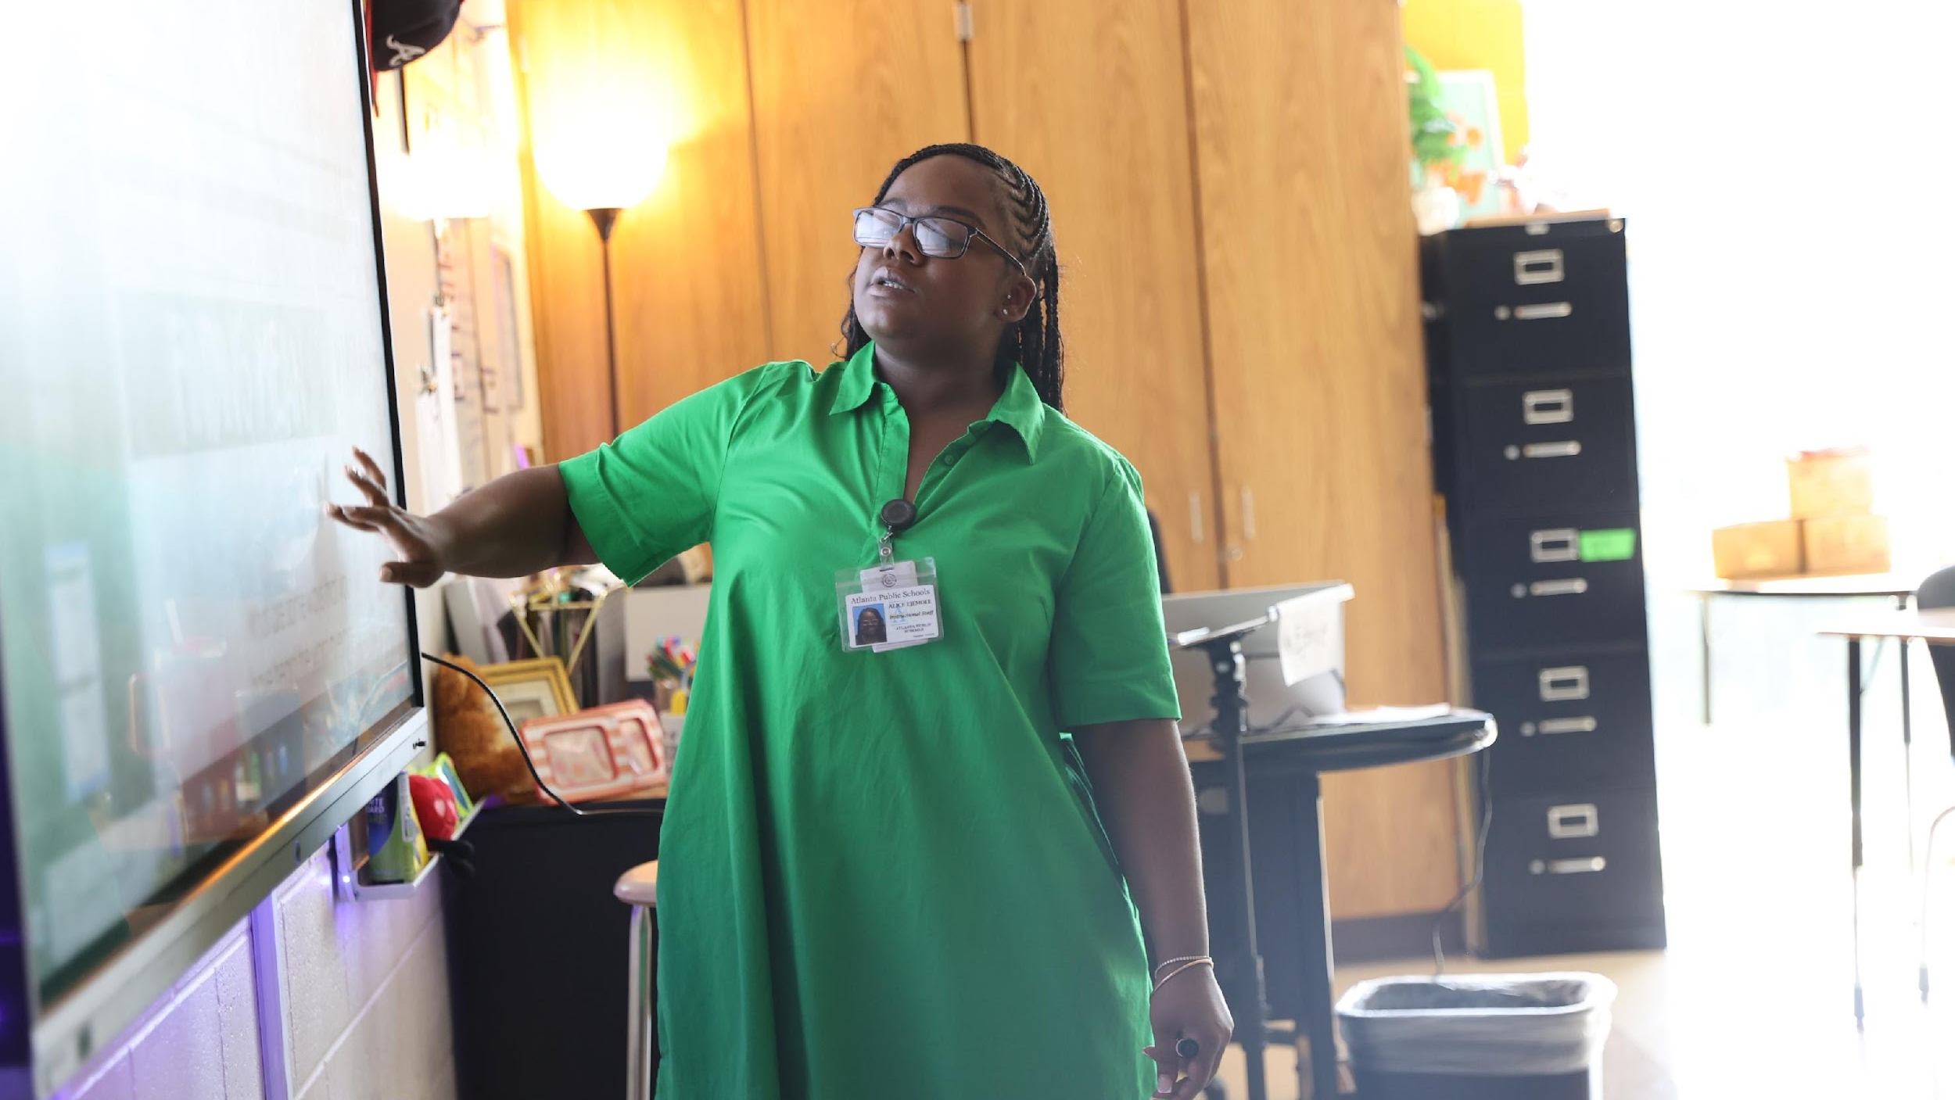

4. Identify 2025-2030 Strategic Objectives
Reflect on 2020-2025 Strategic Plan (Stop, Continue)
Align Objectives to the District's new Focus Areas
Review and Discuss Additional Objectives Going Forward (Start)
One District. One Goal. Every Child.

Slide 15
West Manor IB World School
SMART Goals
During the 2025 school year we will Increase the number of students in grades 3-5 scoring proficient from 35 % to 40% on ELA Milestones
During the 2025 school year we will Increase the number of students in grades 3-5 scoring proficient from 32 % to 37% on Math Milestones
During the 2025 School year we will increase the number of students with 10 or less days absent from 74% to 80%
APS Strategic Priorities & Initiatives
School Strategic Priorities
School Strategies
Fostering Academic Excellence for All
Data
Curriculum & Instruction
Signature Program
1.
3.
1A. Implementation of an intervention block to reduce gaps in learning
1B. Employ a literacy block with phonics for grades k-2
1C. Create PLC planning time for teachers to internalize standards and plan for instruction
Increase student phonic awareness and create early readers
Increase student knowledge in numbers and operations domain
Increase student multiplication skills
Building a Culture of Student Support
Whole Child & Intervention
Personalized Learning
Increase student attendance and decrease suspension rate
TBD: Create an attendance team to monitor and address attendance concerns, Create a Care Team to address student needs
TBD: Utilize SLC practices and restorative justice with the Counselor to reduce suspensions
Equipping & Empowering Leaders & Staff
Strategic Staff Support
Equitable Resource Allocation
Increasing Teacher knowledge of Standards
Increase Teacher knowledge of IB Program
TBD: Monthly IB training for staff, Professional development individualized around teacher needs in reading and math, training for phonics program (Fundations)
Ongoing PD for SEL, restorative practices, and trauma
Creating a System of School Support
Collective Action, Engagement & Empowerment
TBD: Conduct data meetings in PLC, with parents and students. Students will also have goal setting meetings with teachers
--Increase Parent Liaison and Social Worker positions to full time to support the needs of students and parents
Improve stakeholder knowledge of school data and how to assist
Provide support to students and stakeholders in need

Slide 16
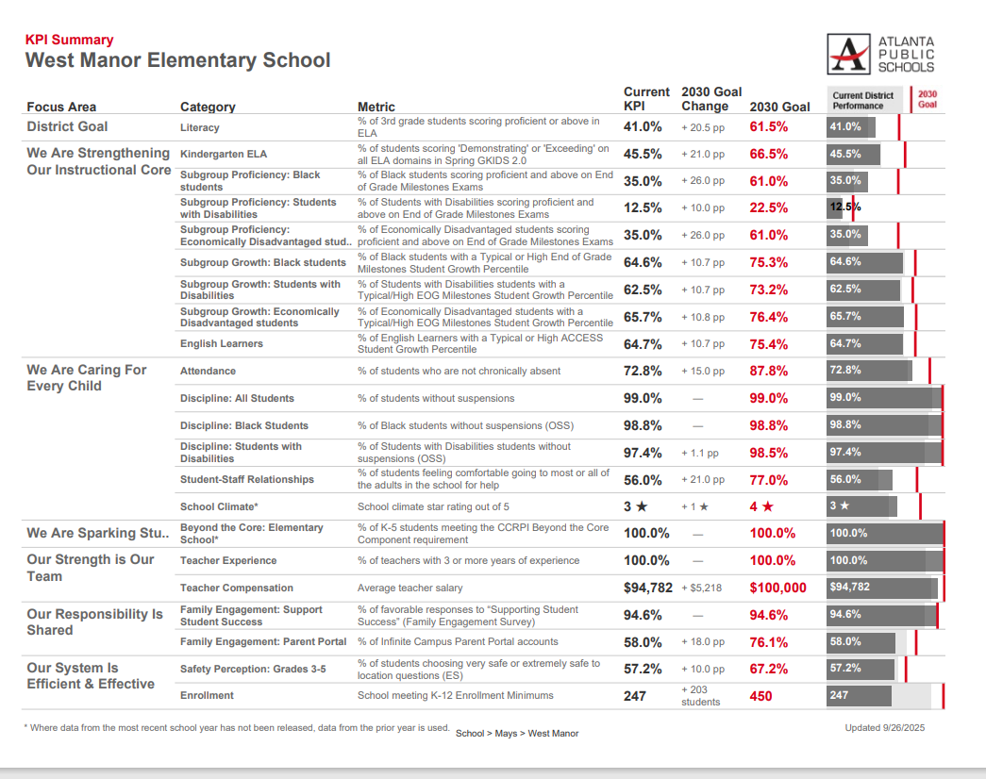
Guiding Questions for the GO Team to Discuss:
What do you notice?
What are your wonderings?
Are you on track?
Are there specific sub-group performance gaps?
Outside of the “Instructional Core,” what could be a focus area?
Notes:
Notes:
These are aligned to the district’s KPI’s
Before identifying missing data, review what is available on this dashboard for strategic importance.
Where data from SY25-26 has not been released, data from the prior year is used.
These are great examples of potential additions to your strategic goals.

Slide 17
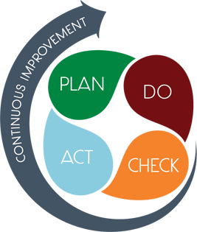
Connecting the
Strategic plan &
Continuous Improvement Plan
1.Increase student phonic awareness and create early readers
Increase student proficiency on ELA assessments by 3%
Milestones and MAP Scores
2. Increase student knowledge of new math standards
Increase student proficiency on Math assessments by 3%
Milestones and MAP Scores
Improve student attendance
Increase average attendance rate from 95% to96%
CCRPI Attendance Rate

Slide 18

Identifying 2025-2030 Strategic Objectives: Continue Discussion
1.Increase student phonic awareness and create early readers
2 Increase student knowledge in numbers and operations domain
3. Increase student multiplication skills
4. Increase student attendance and decrease suspension rate
5.Increasing Teacher knowledge of Standards
6.Increase Teacher knowledge of IB Program
7. Improve stakeholder knowledge of school data and how to assist
8. Provide support to students and stakeholders in need

Slide 19
Aligning Your Objectives to the District's New Focus Areas
“Getting Back to Basics”
“Community of Believers”
Our Strength is Our Team
Implement high quality, relevant, and engaging materials and professional learning in all core content areas
Retain effective staff while training and promoting from within
Our Responsibility Is Shared
Improve stakeholder knowledge of school data and how to assist
Improve communication and partnerships with stakeholders
Our School Is Efficient & Effective
Maximize facility usage
We Are Strengthening Our Instructional Core
Increasing Teacher knowledge of Standards
Increase student phonic awareness and create early readers
Increase student knowledge in numbers and operations domain
We Are Caring For Every Child
Provide support to students and stakeholders in need
Increase student attendance and decrease suspension rate
We Are Sparking Student Curiosity
Increase Teacher knowledge of IB Program
Continue to provide clubs and extra curricular activities
Notes:
Use the APS 2025-2030 Strategic Plan (slide 7) and your school's KPI sheet to help guide your team's discussion of how your objectives align to the district's new focus areas.

Slide 20
Guiding Questions: Are there any new “objectives” we must START to completely address our 2025-2030 Strategic Goals? Do we have 1-2 Objectives to support each Focus Area?
“Getting Back to Basics”
“Community of Believers”
We Are Strengthening Our Instructional Core
Increasing Teacher knowledge of Standards
Increase student phonic awareness and create early readers
Increase student knowledge in numbers and operations domain
We Are Caring For Every Child
Provide support to students and stakeholders in need
Increase student attendance and decrease suspension rate
We Are Sparking Student Curiosity
Increase Teacher knowledge of IB Program
Continue to provide clubs and extra curricular activities
Our Strength is Our Team
Implement high quality, relevant, and engaging materials and professional learning in all core content areas
Retain effective staff while training and promoting from within
Our Responsibility Is Shared
Improve stakeholder knowledge of school data and how to assist
Improve communication and partnerships with stakeholders
Our School Is Efficient & Effective
Maximize facility usage

Slide 21
Where we’re going
At our next meeting we will:
Vote on the 2025-2030 Strategic Plan
Rank our 2025-2030 Strategic Objectives
Begin the discussion of the 2026-2027 budget
Let me or the Chair know of any additional information you need for our future discussion.

Slide 22
Information Items

Slide 23
Principal’s Report
Successful IB Authorization Visit
West Manor safe for Facilities Planning
MAP Testing the week of 12/8
West Manor placed 3rd in the state for the Prodigy challenge in August
13 West Manor Students celebrated as LEAD Community Champions

Slide 24
Cluster Advisory Team Report
Next meeting 11/18
Priorities will be set based on Cluster Key Performance indicators (ELA, 8th Grade Math & Attendance

Slide 25



APS Forward 2040:
Reshaping the Future of Education
Taskforce Meetings
May 8, 2025 - Presentation
August 5, 2025- Presentation
Upcoming Public Meetings
October 20
November 10
Virtual – at Noon
In-person at 6PM at CLL (130 Trinity Ave)
UPDATE
Comprehensive Long-Range Facilities Plan
atlantapublicschools.us/APS2040
Notes:
Next on our agenda, we’d like to welcome our representative to the Long-Range Comprehensive Facilities Master Plan Taskforce. As many of you know, this taskforce plays a key role in shaping the future of our district’s facilities — ensuring they are aligned with projected enrollment, instructional needs, safety standards, and long-term community use."
Over the summer, the taskforce has been hard at work reviewing data, exploring options, and engaging in important planning conversations. [Name of Representative] will share an update on what’s been done so far, any key decisions or recommendations that have been made, and what’s ahead — including opportunities for the public to provide input.
[Allow the FMP representative to provide an update and answers questions. After this is concluded:]
Thank you [Name of Representative].
A report will be presented to the Board at its August 11 meeting, and the options will become public the week of August 18.
There are several upcoming public meetings where you can learn more and share your thoughts. The next public meetings are scheduled for: August 25, October 20, and November 10
On each date, there will be a virtual meeting at noon and an in-person meeting at the Central Office at 6PM.
I strongly encourage you all to attend these meetings. This is a critical time for public input, and your voice is essential.

Slide 26
Announcements

Slide 27
Thank you

